Slide 1
A Joint Calibration–Forecast Weighting Scheme for Ensemble Forecasting of Outbreak Trajectories
AMS FALL 2026 SOUTHEASTERN SECTIONAL MEETING
Concept, pipeline and a worked example on a simulated Ebola outbreak
Raj Subedi & Gerardo Chowell
School of Public Health, Georgia State University
Code and results: https://github.com/rajsubediresearch/AMS-2026
Notes:
Thank you for being here. My name is Raj Subedi. I am a PhD student in epidemiology at Georgia State University, and this is joint work with my advisor, Dr. Gerardo Chowell. The title of my talk is "A Joint Calibration–Forecast Weighting Scheme for Ensemble Forecasting of Outbreak Trajectories." Our abstract mentions measles, but today I will use a simulated Ebola outbreak. The concept and the steps are exactly the same, and the shape of this outbreak — growth, a clear peak, and a long decline — makes the weighting question easy to see. I will spend about fifteen minutes on the idea, the pipeline, and the results, and then leave time for discussion. If time permits, I will also walk through the code, which is on GitHub at the link on the screen.

Slide 2
How should ensemble members be weighted?
BACKGROUND
Ensembles of growth models usually forecast better than any single model. The open question is how much weight each model gets, and what evidence the weights should use.
STANDARD
PROPOSED
Calibration-only weights
Joint calibration–forecast (JCF)
Weight ∝ 1 / WIS on the calibration window. Rewards how well a model fits the data it has already seen.
Also rewards how well the model actually forecast in the previous window, blended by a single parameter λ.
JCF ensemble forecasting · AMS Fall 2026
2
Notes:
Let me start with the question. When we forecast an epidemic, we often fit several simple growth models and combine them into an ensemble, because ensembles usually forecast better than any single model. The open question is how much weight each model should get. The standard approach, on the left, is calibration-only weighting. Each model gets a weight proportional to one over its weighted interval score on the calibration window. The weighted interval score, or WIS, rewards prediction intervals that are sharp but still cover the data, and lower is better. The problem is that this rewards how well a model fits data it has already seen, and a good fit does not guarantee a good forecast. Our proposal, on the right, is joint calibration–forecast weighting, or JCF. It also rewards how well each model actually forecast in the previous window — evidence we already have when we issue the next forecast. A single parameter, lambda, controls the blend.

Slide 3
Three phenomenological growth models
METHODS · MODELS
Generalized logistic (GLM)
Richards
Gompertz
C′(t) = r C [1 − (C/K)ᵃ]
C′(t) = r C e⁻ᵃᵗ
C′(t) = r Cᵖ (1 − C/K)
a controls the asymmetry of the epidemic curve around its peak.
Growth rate decays exponentially in time; no explicit final size K.
p ∈ (0, 1] scales growth from sub-exponential to exponential; p = 1 is the logistic.
C(t) = cumulative cases; models are fitted to incidence C′(t) by least squares (normal errors), 20 multistart points, and 300 parametric bootstrap refits per window for 95% prediction intervals.
JCF ensemble forecasting · AMS Fall 2026
3
Notes:
We use three phenomenological growth models. Here, C of t is the cumulative number of cases, and we fit the models to incidence, C prime of t. The first is the generalized logistic model. The parameter p scales early growth from sub-exponential to exponential, and when p equals one it reduces to the classic logistic model. So the logistic model in our abstract is included as a special case. The second is the Richards model, where the parameter a controls how asymmetric the epidemic curve is around its peak. The third is the Gompertz model, where the growth rate decays exponentially in time and there is no explicit final size. All three are fitted by least squares with normal errors, using twenty starting points for the optimizer. To quantify uncertainty, we use a parametric bootstrap. We simulate new data around the best fit, refit three hundred times in every window, and use the spread of those trajectories to build ninety-five percent prediction intervals.

Slide 4
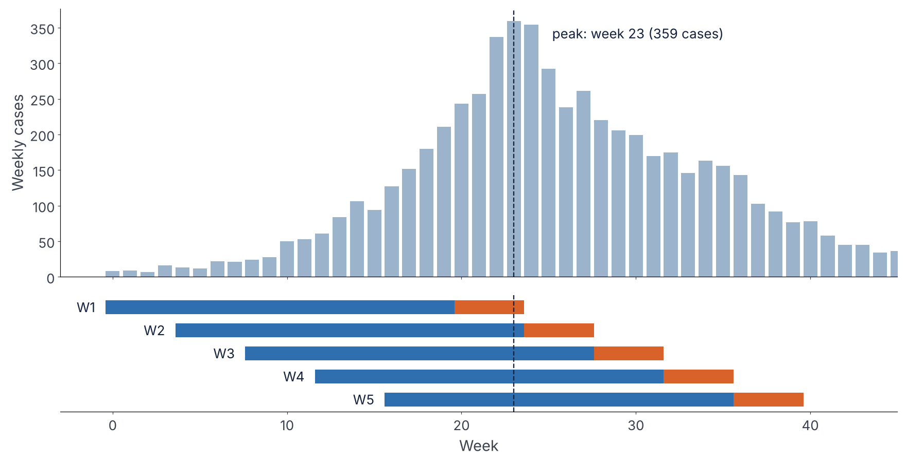
Simulated Ebola outbreak, five rolling windows
METHODS · DATA AND DESIGN
45 weeks · 5,765 cases
Calibration C = 20 weeks
Forecast H = 4 weeks ahead
Shift s = 4 weeks → 5 windows
H ≤ s: each window's forecast is fully observed before the next window is issued, so JCF never looks ahead.
JCF ensemble forecasting · AMS Fall 2026
4
Notes:
This is our dataset: a simulated Ebola outbreak, forty-five weeks long, with five thousand seven hundred sixty-five cases in total. It peaks at week twenty-three with three hundred fifty-nine cases, shown by the dashed line. Below the curve are our five rolling windows. Each window calibrates on twenty weeks, shown in blue, and then forecasts four weeks ahead, shown in orange. Each new window starts four weeks after the previous one. Notice window two. Its calibration ends exactly at the peak, so it has to forecast the first weeks of decline without having seen any sign of the turn. Windows three to five are all in the decline. One design rule matters for JCF: the forecast horizon must be no longer than the shift between windows. That guarantees that each window's forecast has been fully observed before the next window is issued, so JCF never uses information from the future.

Slide 5
Seven pipeline steps, one command each
METHODS · PIPELINE
1
2
3
4
Fit models
Collect metrics
Baseline ensemble
Baseline plots
3 models × 5 windows, 300 bootstraps each
MAE, MSE, coverage, WIS, AICc per model and window
Weights ∝ 1 / calibration WIS, linear pool
Fits and forecasts for every window
batch_*_ebola_scenario1
collect_metrics_simple()
create_ensemble_simple()
plot_forecasts_simple()
5
6
7
Check
JCF ensembles
Compare schemes
JCF plots
Passed
λ ∈ {0, 0.25, 0.5, 0.75, C/(C+H), 1}
Scheme table and weight trajectories
Weights, λ sensitivity, WIS by window
λ = 1 reproduces the step 3 baseline exactly
run_jcf_sweep()
compare_ensembles_jcf()
plot_forecasts_jcf()
JCF ensemble forecasting · AMS Fall 2026
5
Notes:
The whole analysis is a seven-step pipeline, and each step is a single MATLAB command. Step one fits the three models in all five windows, with three hundred bootstrap refits each. This is the slow step. Step two collects the metrics — mean absolute error, mean squared error, coverage, WIS, and AICc — for every model and window. Step three builds the baseline ensemble with calibration-only weights and a linear pool, and step four plots it. Step five runs JCF for six values of lambda, step six compares all the schemes, and step seven makes the JCF figures. An important practical point: both inputs that JCF needs come out of step two. So trying a new weighting scheme only means re-running steps five to seven, which takes seconds. We also have a built-in check. With lambda equal to one, JCF is algebraically the same as calibration-only weighting, and it reproduces step three exactly, to the last digit.

Slide 6
JCF: blend calibration and recent forecast skill
METHODS · WEIGHTING RULE
score(i, w) = λ · WIScal(i, w) + (1 − λ) · WISfc(i, w − 1)
weight(i, w) = [1 / score(i, w)] / Σⱼ [1 / score(j, w)]
Model i, window w. Members are combined by a weighted linear pool of their bootstrap trajectories.
λ = 1
λ = 0
λ = C/(C+H)
Window 1
Calibration-only baseline
Previous forecast score only
= 0.833: every observed point counts equally
No previous forecast, so identical to baseline
JCF ensemble forecasting · AMS Fall 2026
6
Notes:
Here is the JCF rule. For model i in window w, we compute a score. The score is lambda times the model's calibration WIS in the current window, plus one minus lambda times the model's forecast WIS in the previous window. The weight is one over that score, normalized so that the weights sum to one. The members are then combined by a weighted linear pool, which is a mixture of their bootstrap trajectories. Lambda is the only tuning parameter. Lambda equal to one gives the calibration-only baseline. Lambda equal to zero uses only the previous forecast score. Lambda equal to C over C plus H, which is zero point eight three three here, weights every observed point equally. And because window one has no previous forecast, it is identical to the baseline by construction. So only windows two to five can tell us whether JCF helps.

Slide 7
No single model wins every window
RESULTS · STEPS 1–2
Window | Forecast weeks | GLM | Richards | Gompertz
1 | 20–23, to peak | 11.8 | 9.1 | 7.0
2 | 24–27, after peak | 73.8 | 85.5 | 98.5
3 | 28–31 | 10.9 | 10.8 | 46.7
4 | 32–35 | 27.6 | 25.6 | 41.9
5 | 36–39 | 42.7 | 40.3 | 52.5
Mean |  | 33.4 | 34.2 | 49.3
Gompertz goes from best in window 1 to clearly worst in windows 3–5.
Window 2 is hard for every model: WIS jumps 6–14× from window 1.
AICc and calibration WIS pick the same model in every window, so calibration-only weights reward in-sample fit.
Forecast WIS, lower is better. Bold = best model in that window.
JCF ensemble forecasting · AMS Fall 2026
7
Notes:
Let us look first at the individual models. This table shows the forecast WIS of each model in each window. Lower is better, and the best model in each window is in bold. Reading across the rows, the winner keeps changing. Gompertz is the best in window one, but it becomes clearly the worst in windows three to five. GLM is the best in window two, and Richards is the best during the decline. Window two is hard for every model: the WIS jumps between six and fourteen times compared with window one. On average, GLM is the best single model, with a mean WIS of thirty-three point four. One more observation: AICc and calibration WIS choose the same best model in every window. So calibration-only weights are really just rewarding in-sample fit. This is the classic argument for an ensemble: we do not know in advance which model will be right.

Slide 8
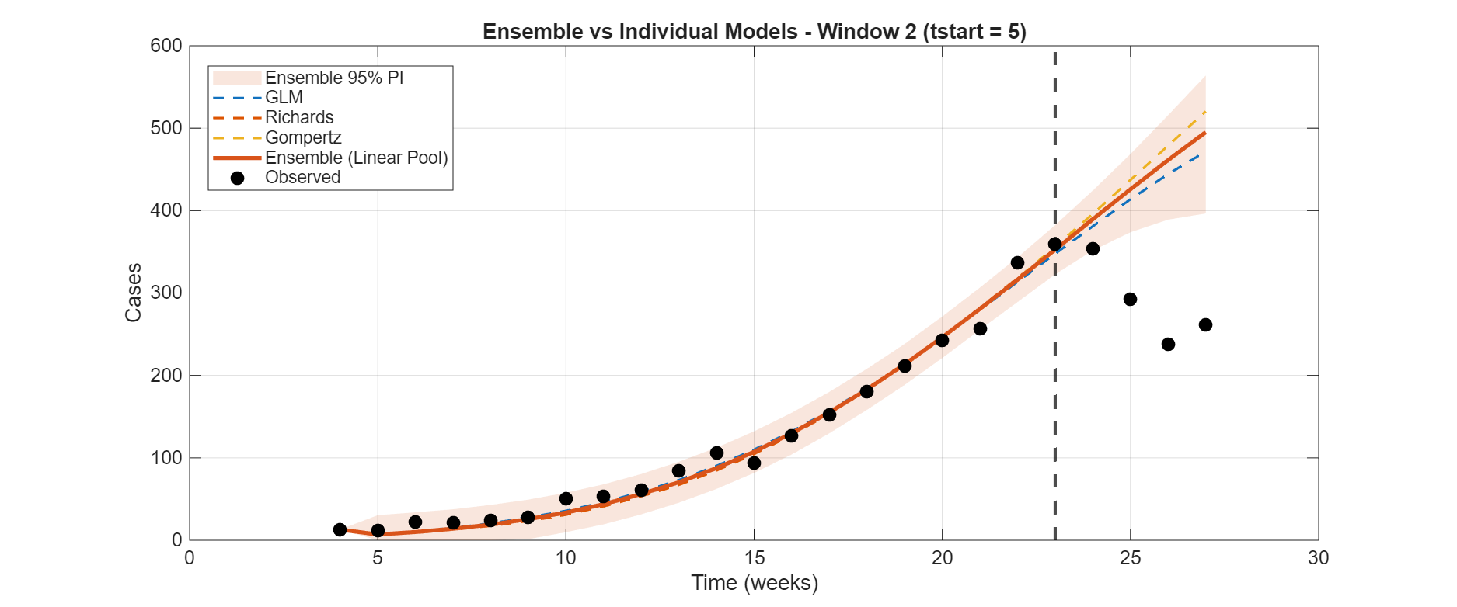
Window 2: calibration ends at the peak
RESULTS · THE TURNING POINT
Every model extrapolates growth while cases fall. Coverage drops to 52% (GLM, Richards) and 0% (Gompertz). Pooling cannot fix a bias that all members share.
JCF ensemble forecasting · AMS Fall 2026
8
Notes:
This figure shows what goes wrong in window two. The dashed line is the end of calibration at week twenty-three, which is exactly the peak. Up to that point, the data show no sign of a turn, so all three models, and the ensemble, keep projecting growth. Meanwhile, the observed cases start to fall, from about three hundred fifty down to about two hundred forty. The coverage of the ninety-five percent intervals drops to fifty-two percent for GLM and Richards, and to zero for Gompertz. The lesson here is simple: an ensemble cannot fix a bias that all of its members share. This is the textbook weakness of phenomenological models at a turning point. Please keep this window in mind, because it is also where JCF's information from the previous window will mislead us.

Slide 9
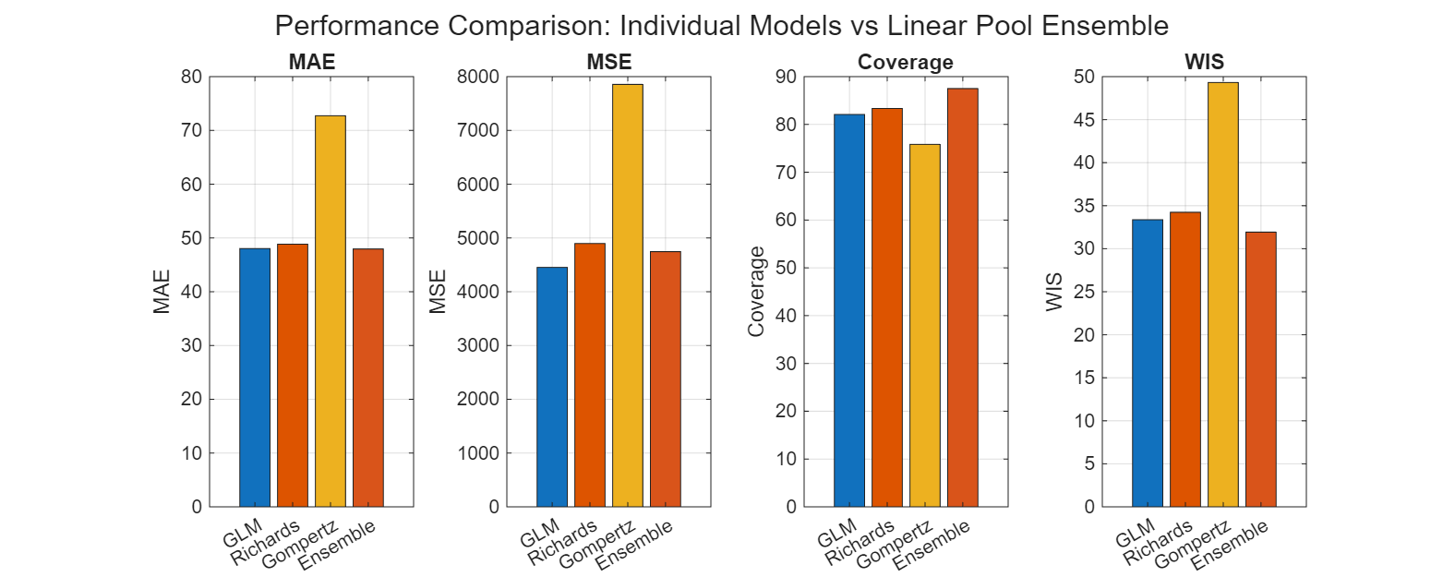
The ensemble beats every single model overall
RESULTS · STEPS 3–4
31.9
Mean WIS, vs 33.4 for GLM (4.3% better)
87.5%
95% PI coverage, vs 76–83% for single models
−19%
WIS vs best single model in windows 4 and 5
JCF ensemble forecasting · AMS Fall 2026
9
Notes:
Now the calibration-only ensemble. Across all five windows, it has a mean WIS of thirty-one point nine, compared with thirty-three point four for GLM, the best single model. That is about four percent better. Its ninety-five percent prediction intervals cover eighty-seven and a half percent of the observations, compared with seventy-six to eighty-three percent for the individual models. And in windows four and five, it is eighteen to nineteen percent better than the best single model. To be fair, the ensemble is not the best in every window. In windows one to three, the best single model does slightly better. But over the whole outbreak, it has the lowest WIS and the best coverage, and it is never the worst. Over time, the weights move away from Gompertz, from about one third in window one down to about eighteen percent in window five.

Slide 10
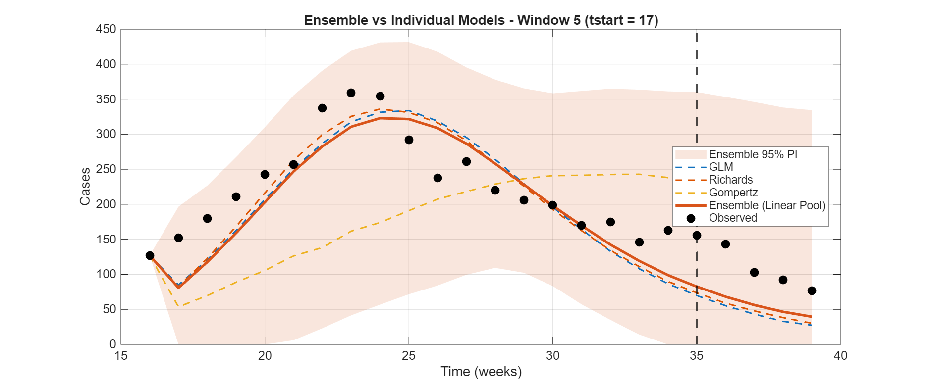
Late windows: members err in opposite directions
RESULTS · WHY THE POOL WINS
Window 5: GLM and Richards decline too fast, Gompertz stays too high, and the observed cases sit between them. A model with a poor score can still help the pool.
JCF ensemble forecasting · AMS Fall 2026
10
Notes:
So why does the ensemble win in the late windows? This is window five. To the right of the dashed line, GLM and Richards forecast a decline that is too fast, from about seventy cases down to thirty. Gompertz stays too high, at a little over two hundred. The observed cases, falling from one hundred forty-three to seventy-seven, sit in between. Because the members err in opposite directions, the mixture covers the truth. The ensemble WIS is thirty-two point nine, compared with forty point three for Richards, the best single model. Window four looks the same. The important lesson is that a model with a poor individual score — here, Gompertz — can still be valuable to the ensemble if it errs in the opposite direction from the others. This point will explain the JCF results.

Slide 11
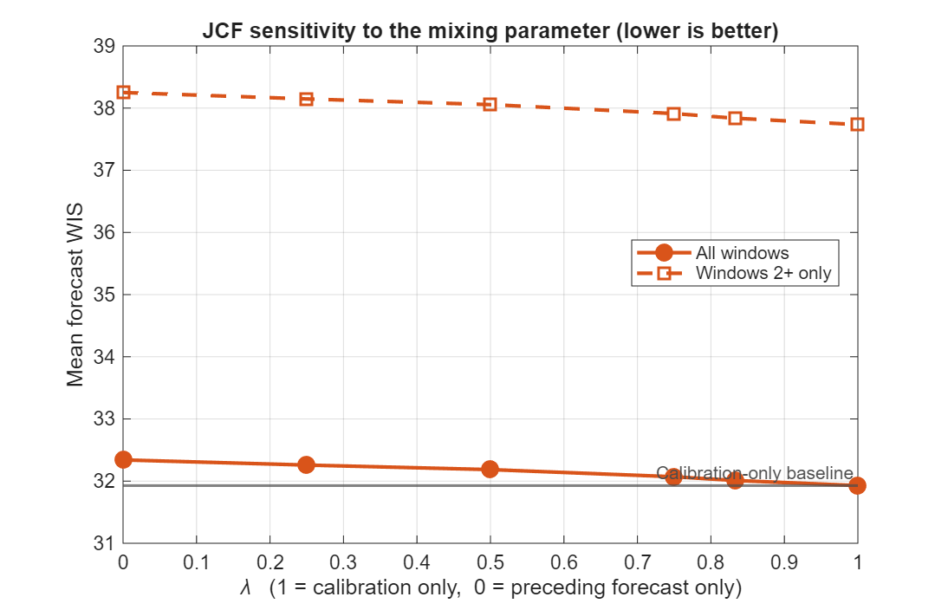
JCF ties calibration-only on this outbreak
RESULTS · STEPS 5–6
λ | Mean WIS | Windows 2–5 | vs baseline
1 (baseline) | 31.93 | 37.73 | 0
0.833 (C/(C+H)) | 32.01 | 37.84 | +0.3%
0.75 | 32.07 | 37.91 | +0.4%
0.5 | 32.18 | 38.06 | +0.8%
0.25 | 32.26 | 38.15 | +1.0%
0 | 32.34 | 38.25 | +1.3%
Forecast WIS, lower is better; + means higher WIS than baseline.
Every λ is within 1.3% of the baseline, over only four windows that can differ: effectively a tie.
JCF ensemble forecasting · AMS Fall 2026
11
Notes:
Now the JCF results. This table shows the mean forecast WIS for each value of lambda, over all windows and over windows two to five, which are the windows where JCF can differ. The honest result is that JCF does not beat calibration-only weighting on this outbreak. As lambda moves from one toward zero, the WIS increases slightly and steadily, from thirty-one point nine three to thirty-two point three four. But the largest difference is only one point three percent, and it comes from just four informative windows. So I would not call JCF harmful here either. The two schemes are essentially tied. The plot on the right shows the same thing: the curve is almost flat. The more interesting story is not in the averages, but in what happens window by window.

Slide 12
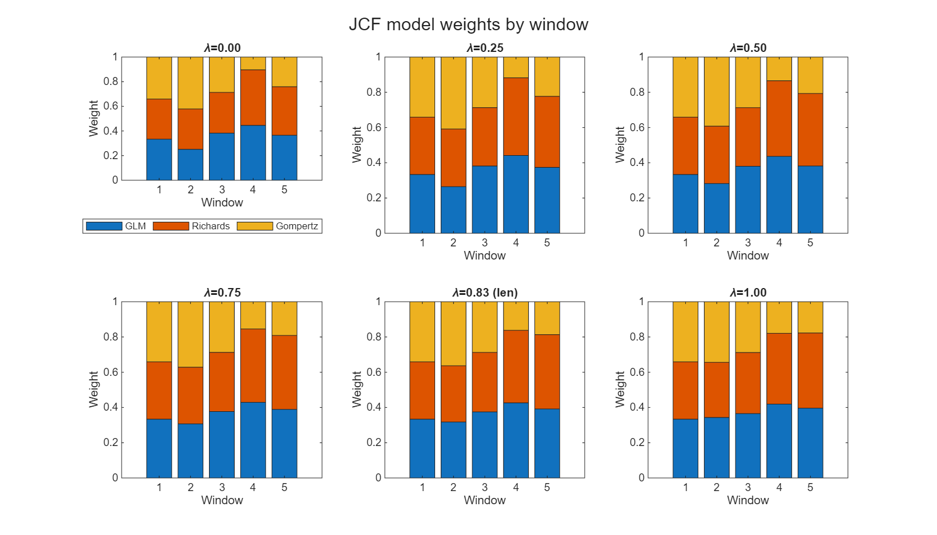
JCF does move the weights as the epidemic turns
RESULTS · STEP 7
GOMPERTZ WEIGHT, W1 → W5
λ = 1 (baseline)
0.34 → 0.34 → 0.29 → 0.18 → 0.18
λ = 0
0.34 → 0.42 → 0.29 → 0.10 → 0.24
Shifting bars mean JCF is reacting to recent forecast skill. Flat bars would mean it does nothing.
JCF ensemble forecasting · AMS Fall 2026
12
Notes:
Before that, let me show that JCF is actually doing something. These stacked bars show the weight of each model in each window, for each value of lambda. At lambda equal to one, the weights drift smoothly. As lambda goes toward zero, they react to the previous window's forecast. Follow Gompertz, the yellow segment at the top. Under the baseline, its weight goes from zero point three four down to zero point one eight. Under lambda equal to zero, it rises to zero point four two in window two, because Gompertz forecast best in window one. It then drops to zero point one zero in window four, and rises again to zero point two four in window five. So the mechanism works: JCF adapts the weights as the epidemic turns. Whether those changes actually help is a separate question.

Slide 13
Where JCF helps and where it hurts
RESULTS · WINDOW BY WINDOW
W | λ = 1 | λ = 0.5 | λ = 0 | What happened
1 | 8.70 | 8.70 | 8.70 | Identical by construction
2 | 83.97 | 85.45 | 86.06 | Worse: Gompertz rewarded for W1, then failed at peak
3 | 13.37 | 13.31 | 13.30 | No real change
4 | 20.67 | 21.72 | 22.76 | Worse (+10%): Gompertz cut, high-side spread lost
5 | 32.92 | 31.74 | 30.88 | Better (−6%): Gompertz up-weighted toward truth
Lesson: past forecast skill is lagged information, and inverse-score weights cannot see which direction a model errs.
JCF ensemble forecasting · AMS Fall 2026
13
Notes:
This table answers that question, window by window. The numbers are forecast WIS, and lower is better. Window one is identical by construction. In window two, JCF does worse. It rewarded Gompertz for forecasting well in window one, but window two is the turning point, where Gompertz did worst. Window three shows no real change. In window four, JCF is worse again, by ten percent at lambda equal to zero. It correctly cut the weight of Gompertz, the worst model, but Gompertz was the only member erring high, so removing it took away the spread that was covering the observations. In window five, the opposite happens. Gompertz's recent forecast was better than its fit, so JCF gave it more weight, and the pool moved toward the truth: six percent better. So there are two lessons. Past forecast skill is lagged information. And inverse-score weights cannot see which direction a model errs.

Slide 14
Four lessons from one outbreak
TAKEAWAYS
1
2
The ensemble is the safer bet: lowest overall WIS, best coverage, never the worst.
JCF adapts the weights as intended, but ties calibration-only here (within 1.3%).
3
4
Past forecast skill is lagged: it misleads exactly at turning points.
Inverse-score weights ignore error direction; a "bad" model erring the other way can be the most useful member.
JCF ensemble forecasting · AMS Fall 2026
14
Notes:
Let me summarize with four lessons. First, the ensemble is the safer bet. It has the lowest overall WIS and the best coverage, and it is never the worst. Second, JCF adapts the weights as intended, but on this outbreak it ties calibration-only weighting, within about one percent. Third, past forecast skill is lagged information, and it misleads exactly at turning points, which is when good forecasts matter most. Fourth, inverse-score weights ignore the direction of the errors. A model that looks bad on its own can be the most useful member if it errs in the opposite direction from the others. If you remember one thing from this talk, it is this: weighting models by their scores is not the same as building a good mixture.

Slide 15
Limitations, next steps and the code
WRAP-UP
Limitations
Next steps
One simulated outbreak, four informative windows
Some parameters hit their bounds (K before the peak, r late)
Each window restarts the cumulative count at the first observation
Least squares with normal errors on count data
Measles (Jalisco) and more outbreaks, more windows
Negative-binomial likelihood
Choose λ adaptively rather than fixing it
Direction-aware or stacking weights
Thank you
rsubedi1@gsu.edu
rajkumarsubedi@gmail.com
Code: https://github.com/rajsubediresearch/AMS-2026
JCF ensemble forecasting · AMS Fall 2026
15
Notes:
I want to be clear about the limitations. This is one simulated outbreak, and only four windows can show a JCF effect. Some parameters hit their bounds: the final size K before the peak, and the growth rate r in the late windows. Each window also restarts the cumulative count at its first observation. This probably hurts Gompertz the most, because its growth decays with time since the start of the window. And we used least squares with normal errors on count data. As next steps, we will apply the pipeline to the measles outbreak in Jalisco and to other outbreaks with more windows, use a negative binomial likelihood, choose lambda adaptively instead of fixing it, and explore weights that account for the direction of the errors, such as stacking. All the code, data, and results are in the AMS 2026 repository on GitHub. Thank you, and I am happy to take questions.

